Slide 1
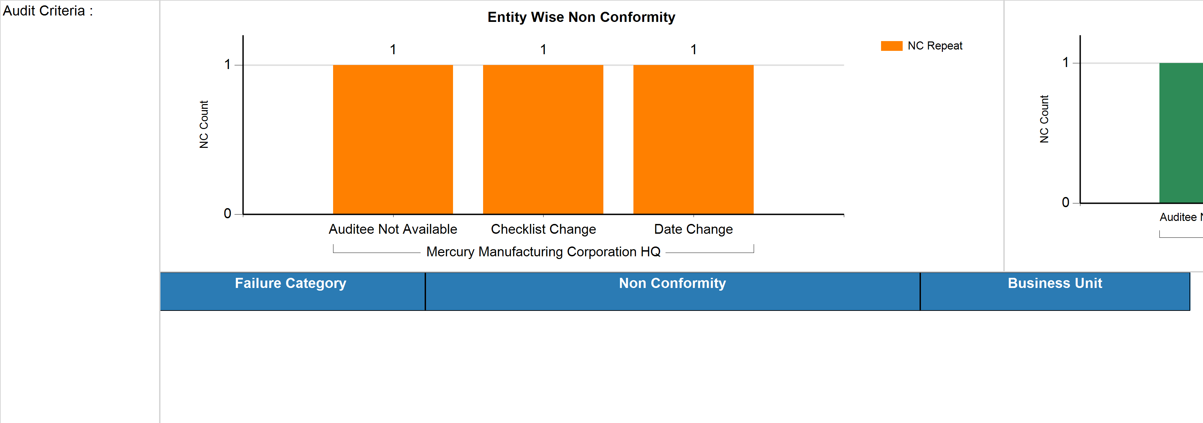
Audit - Repeat Non Conformance
ETL Job Last Executed On (Date & Time) :
30 Apr 2021 04:11:39 PM
Category :
Auto Components
Classification :
Automobiles & Component
Retention Period:
April - June_Q2_2021

Slide 2
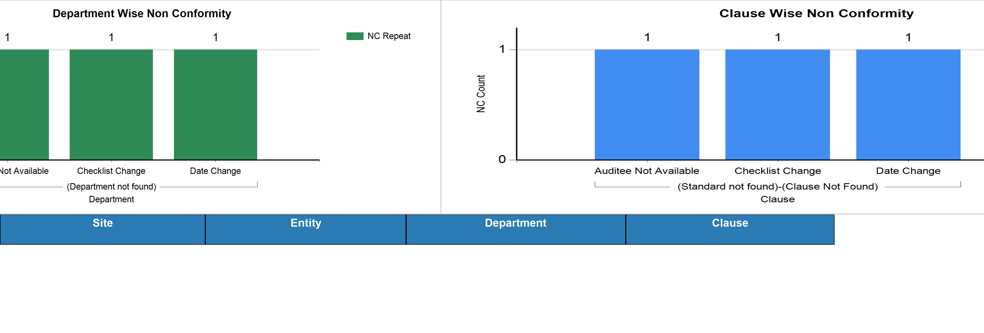
Audit - Repeat Non Conformance
ETL Job Last Executed On (Date & Time) :
30 Apr 2021 04:11:39 PM
Category :
Auto Components
Classification :
Automobiles & Component
Retention Period:
April - June_Q2_2021

Slide 3
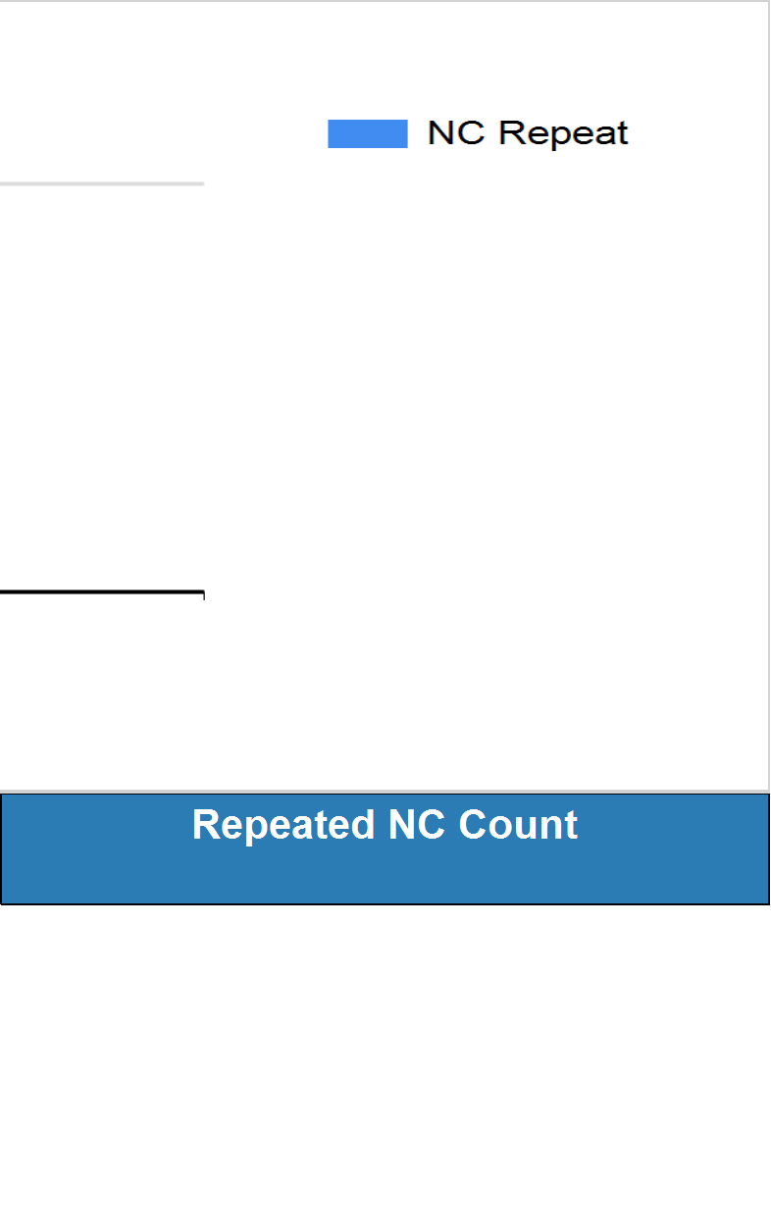
Audit - Repeat Non Conformance
ETL Job Last Executed On (Date & Time) :
30 Apr 2021 04:11:39 PM
Category :
Auto Components
Classification :
Automobiles & Component
Retention Period:
April - June_Q2_2021

Slide 4
Audit - Repeat Non Conformance
ETL Job Last Executed On (Date & Time) :
30 Apr 2021 04:11:39 PM
Category :
Auto Components
Classification :
Automobiles & Component
Retention Period:
April - June_Q2_2021

Slide 5
Audit - Repeat Non Conformance
ETL Job Last Executed On (Date & Time) :
30 Apr 2021 04:11:39 PM
Category :
Auto Components
Classification :
Automobiles & Component
Retention Period:
April - June_Q2_2021

Slide 6
Audit - Repeat Non Conformance
ETL Job Last Executed On (Date & Time) :
30 Apr 2021 04:11:39 PM
Category :
Auto Components
Classification :
Automobiles & Component
Retention Period:
April - June_Q2_2021

