Slide 1
Consolidated Findings Report
Click here to view findings report
ETL Job Last Executed On (Date & Time) :
27 Apr 2021 12:55:29 PM
Category :
Auto Components
Classification :
Automobiles & Component

Slide 2
Consolidated Findings Report
Click here to view findings report
ETL Job Last Executed On (Date & Time) :
27 Apr 2021 12:55:29 PM
Category :
Auto Components
Classification :
Automobiles & Component

Slide 3
Consolidated Findings Report
Click here to view findings report
ETL Job Last Executed On (Date & Time) :
27 Apr 2021 12:55:29 PM
Category :
Auto Components
Classification :
Automobiles & Component

Slide 4
Consolidated Findings Report
Click here to view findings report
ETL Job Last Executed On (Date & Time) :
27 Apr 2021 12:55:29 PM
Category :
Auto Components
Classification :
Automobiles & Component

Slide 5
Consolidated Findings Report
Click here to view findings report
ETL Job Last Executed On (Date & Time) :
27 Apr 2021 12:55:29 PM
Category :
Auto Components
Classification :
Automobiles & Component

Slide 6
Consolidated Findings Report
Click here to view findings report
ETL Job Last Executed On (Date & Time) :
27 Apr 2021 12:55:29 PM
Category :
Auto Components
Classification :
Automobiles & Component

Slide 7
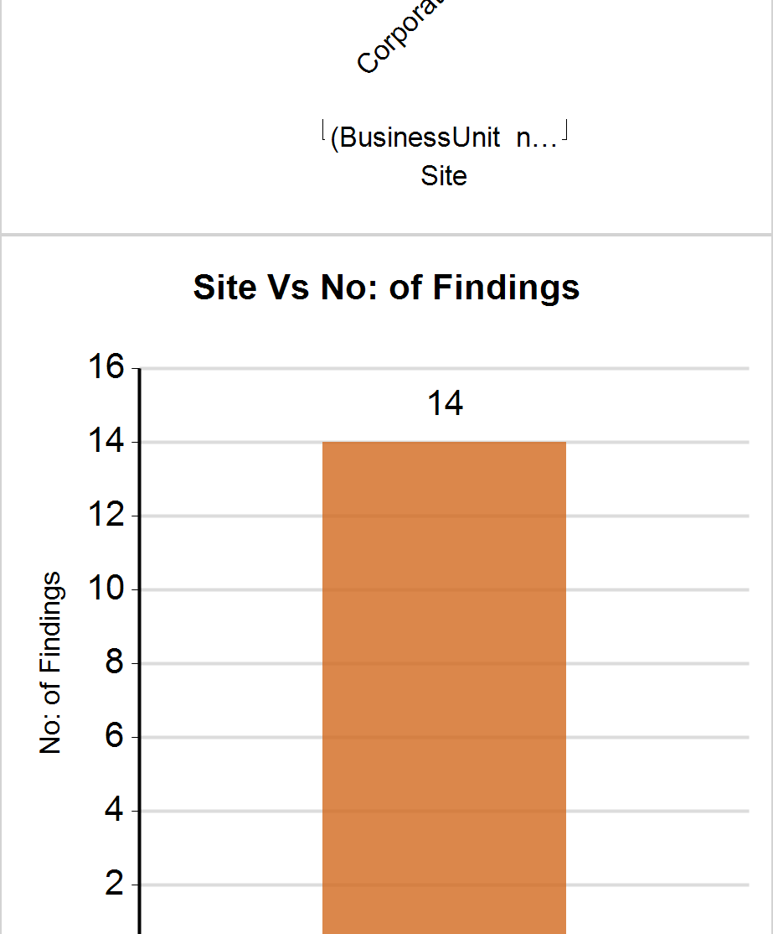
Consolidated Findings Report
Click here to view findings report
ETL Job Last Executed On (Date & Time) :
27 Apr 2021 12:55:29 PM
Category :
Auto Components
Classification :
Automobiles & Component

Slide 8
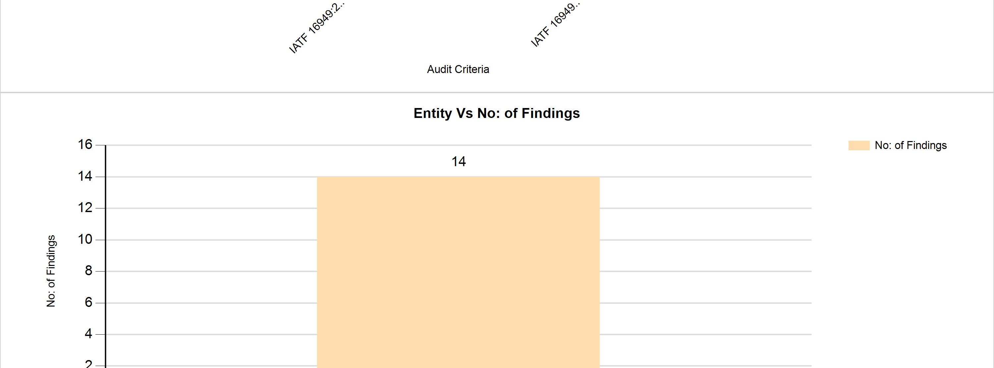
Consolidated Findings Report
Click here to view findings report
ETL Job Last Executed On (Date & Time) :
27 Apr 2021 12:55:29 PM
Category :
Auto Components
Classification :
Automobiles & Component

Slide 9
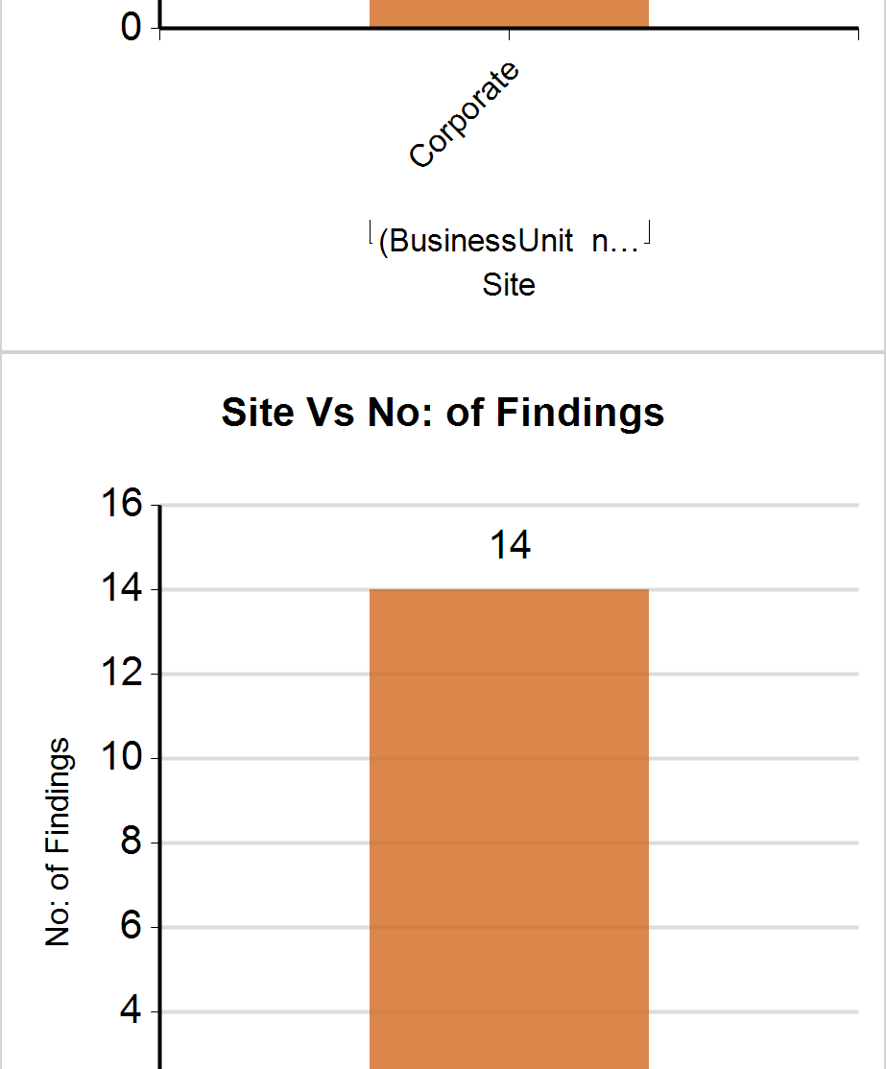
Consolidated Findings Report
Click here to view findings report
ETL Job Last Executed On (Date & Time) :
27 Apr 2021 12:55:29 PM
Category :
Auto Components
Classification :
Automobiles & Component

Slide 10
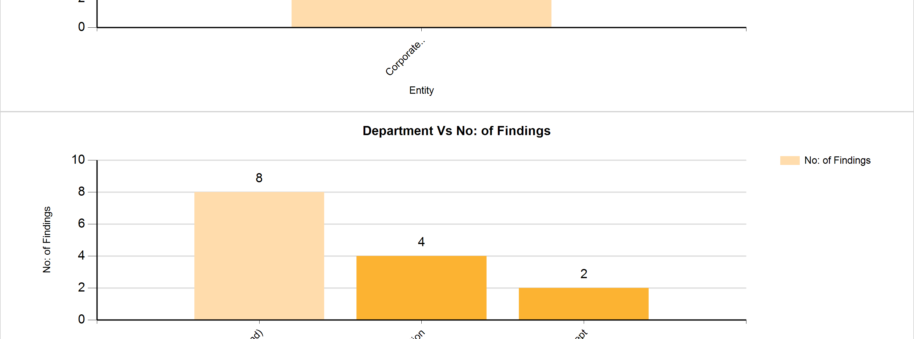
Consolidated Findings Report
Click here to view findings report
ETL Job Last Executed On (Date & Time) :
27 Apr 2021 12:55:29 PM
Category :
Auto Components
Classification :
Automobiles & Component

Slide 11
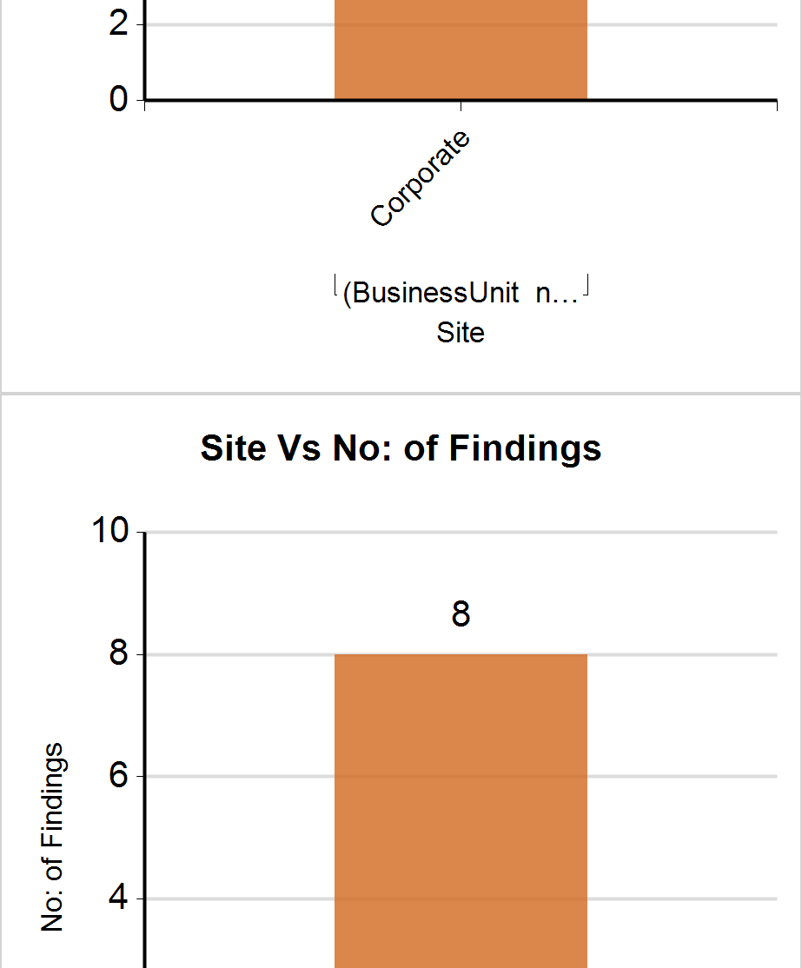
Consolidated Findings Report
Click here to view findings report
ETL Job Last Executed On (Date & Time) :
27 Apr 2021 12:55:29 PM
Category :
Auto Components
Classification :
Automobiles & Component

Slide 12
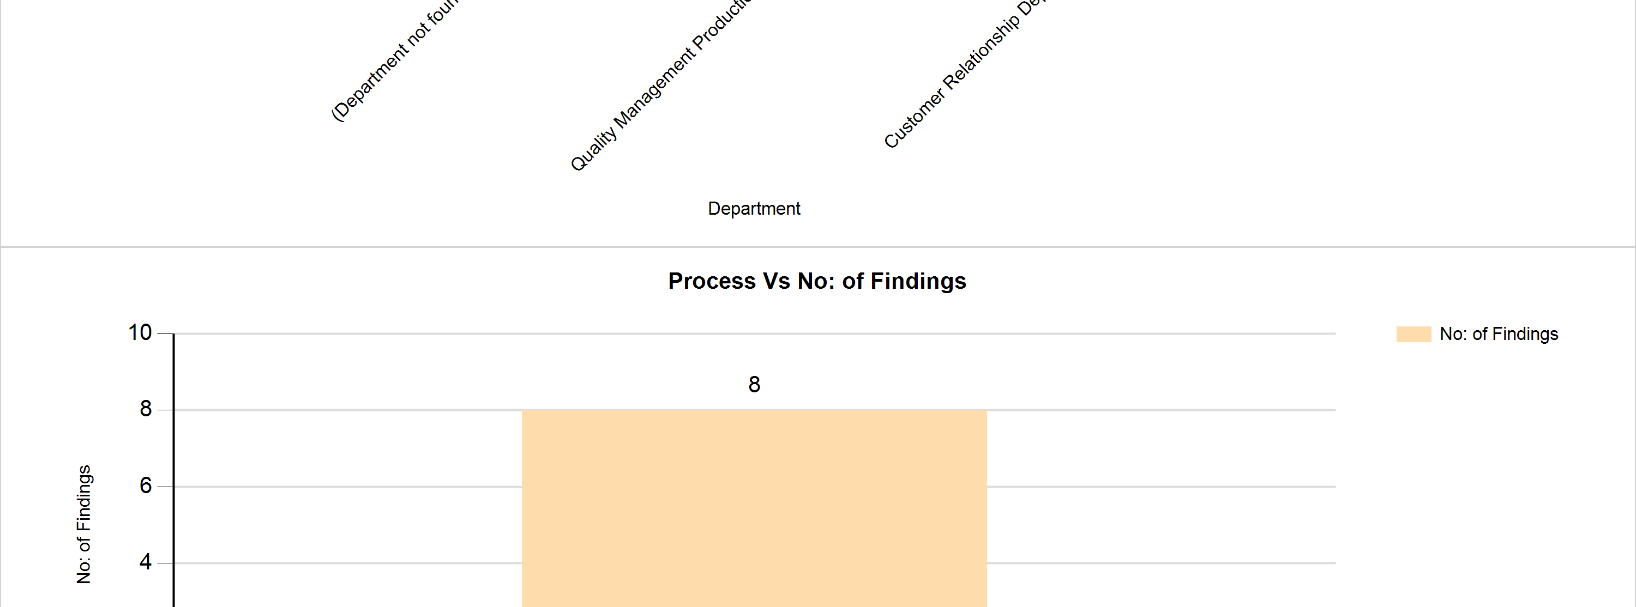
Consolidated Findings Report
Click here to view findings report
ETL Job Last Executed On (Date & Time) :
27 Apr 2021 12:55:29 PM
Category :
Auto Components
Classification :
Automobiles & Component

Slide 13
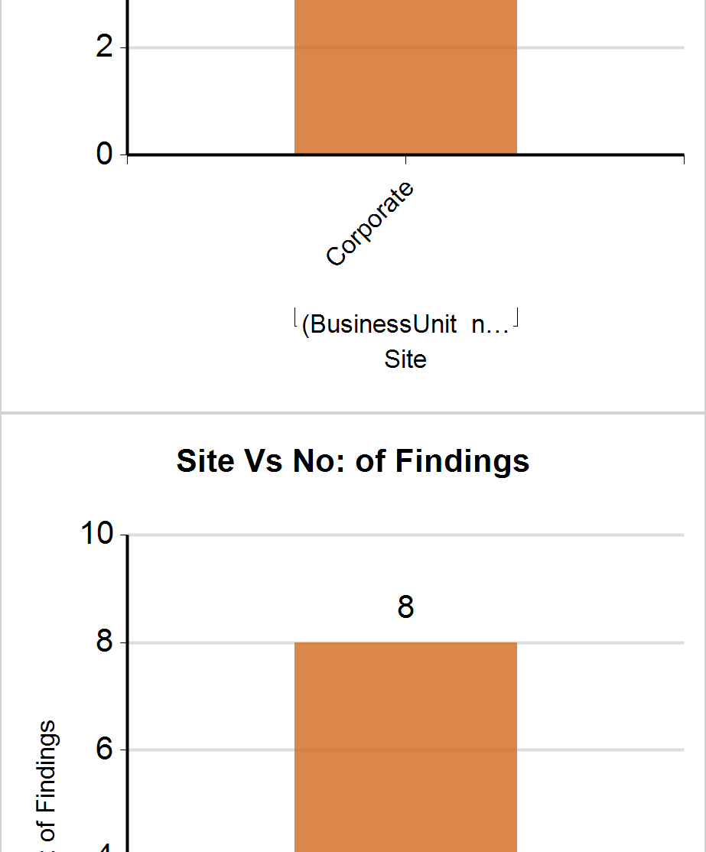
Consolidated Findings Report
Click here to view findings report
ETL Job Last Executed On (Date & Time) :
27 Apr 2021 12:55:29 PM
Category :
Auto Components
Classification :
Automobiles & Component

Slide 14
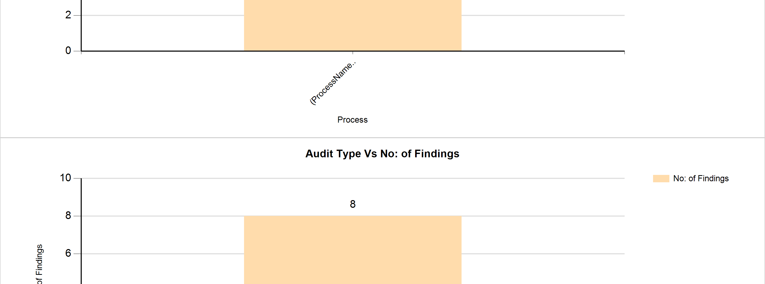
Consolidated Findings Report
Click here to view findings report
ETL Job Last Executed On (Date & Time) :
27 Apr 2021 12:55:29 PM
Category :
Auto Components
Classification :
Automobiles & Component

Slide 15
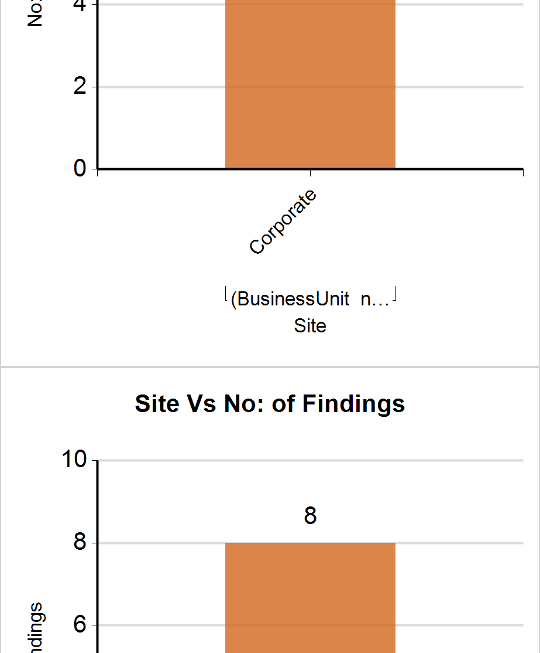
Consolidated Findings Report
Click here to view findings report
ETL Job Last Executed On (Date & Time) :
27 Apr 2021 12:55:29 PM
Category :
Auto Components
Classification :
Automobiles & Component

Slide 16
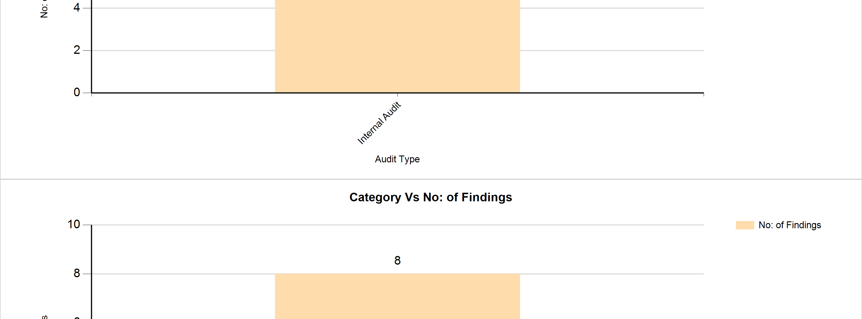
Consolidated Findings Report
Click here to view findings report
ETL Job Last Executed On (Date & Time) :
27 Apr 2021 12:55:29 PM
Category :
Auto Components
Classification :
Automobiles & Component

Slide 17
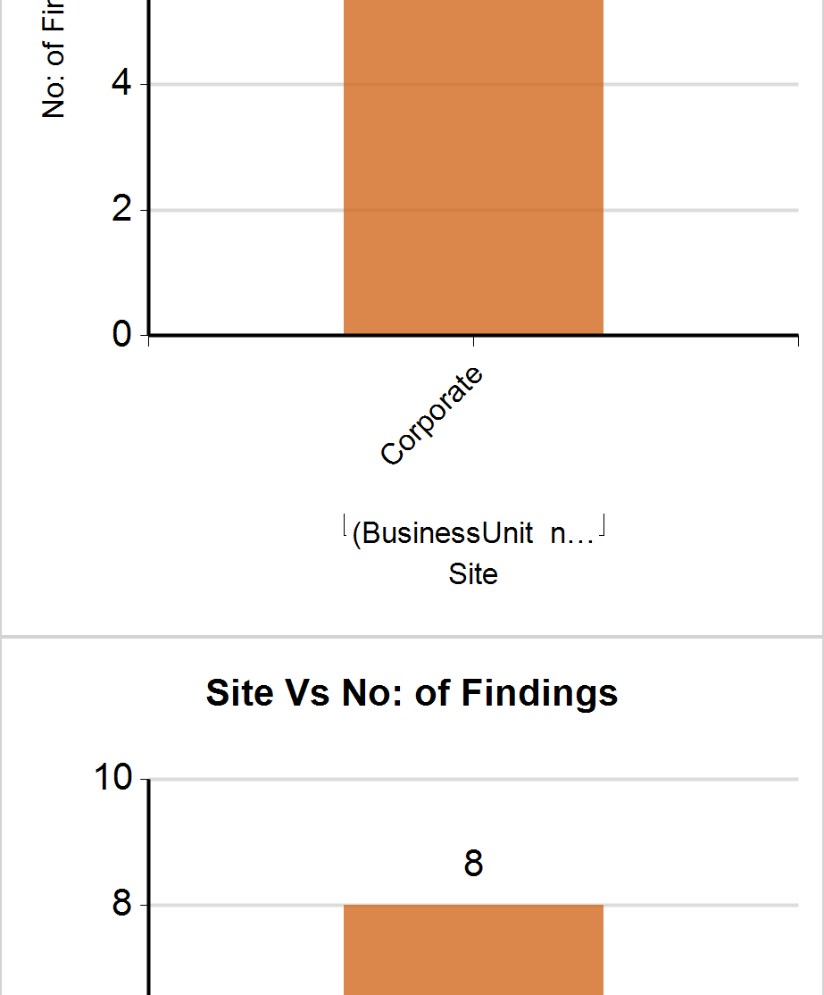
Consolidated Findings Report
Click here to view findings report
ETL Job Last Executed On (Date & Time) :
27 Apr 2021 12:55:29 PM
Category :
Auto Components
Classification :
Automobiles & Component

Slide 18
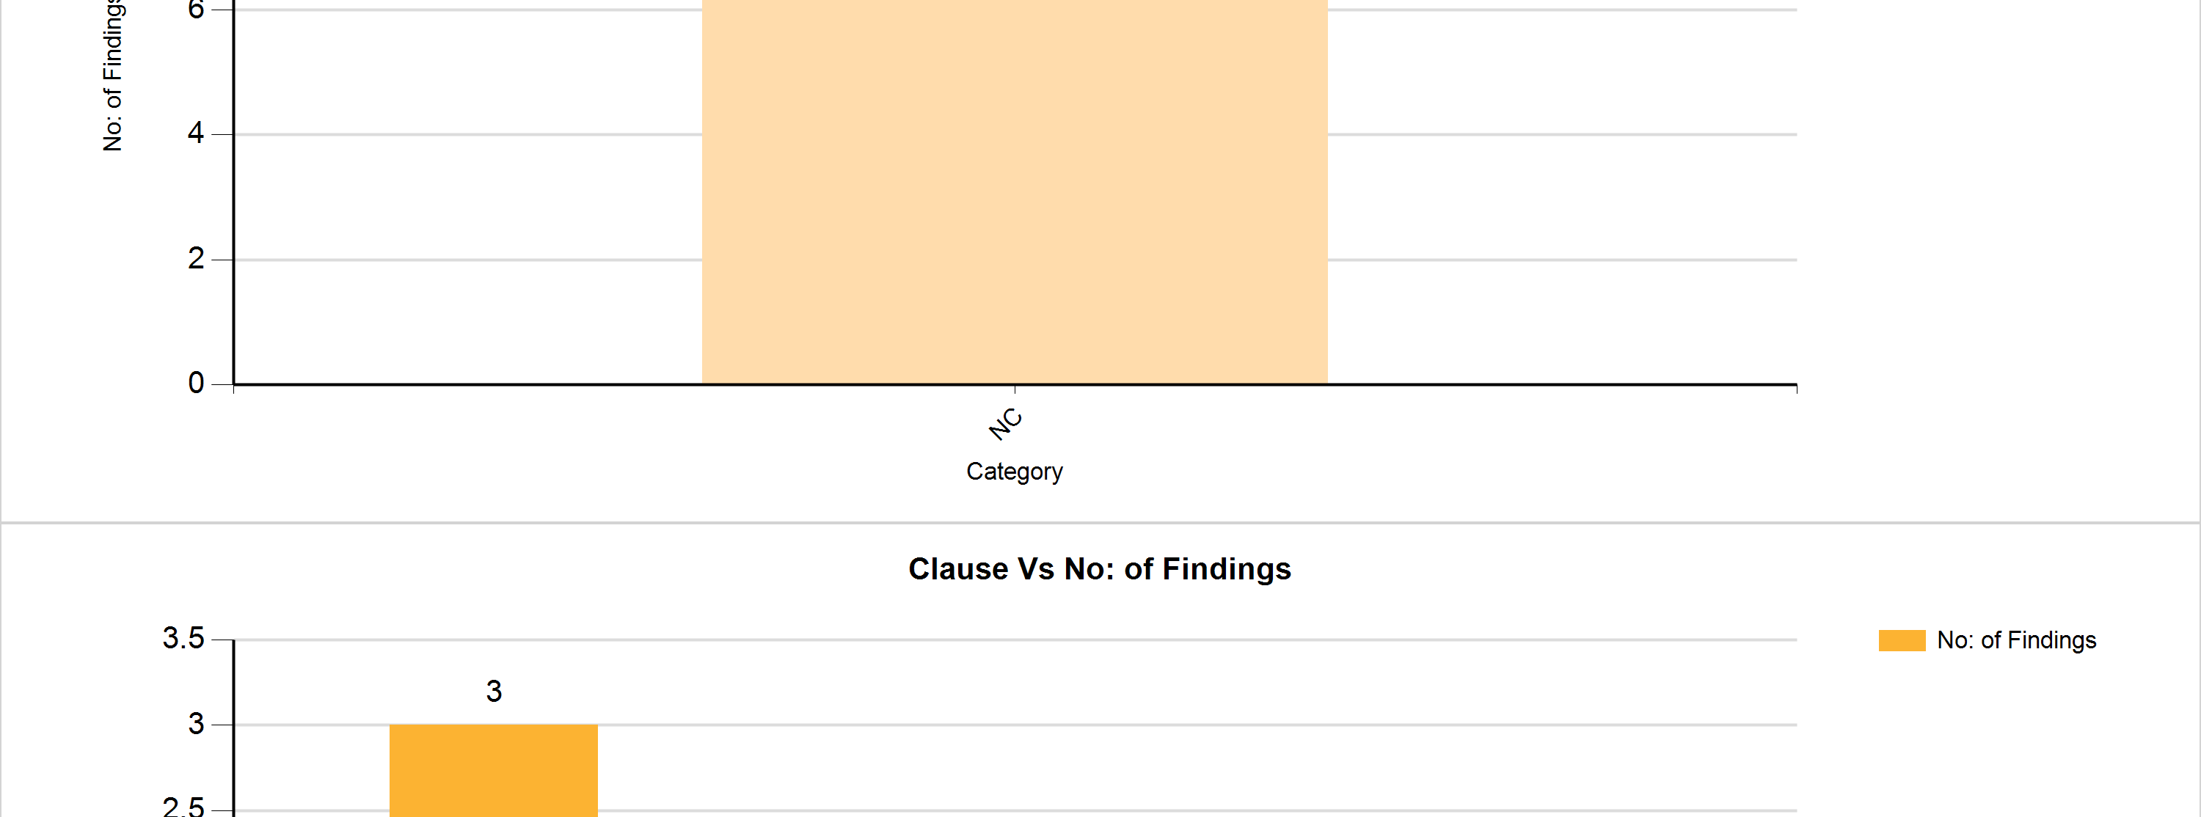
Consolidated Findings Report
Click here to view findings report
ETL Job Last Executed On (Date & Time) :
27 Apr 2021 12:55:29 PM
Category :
Auto Components
Classification :
Automobiles & Component

Slide 19
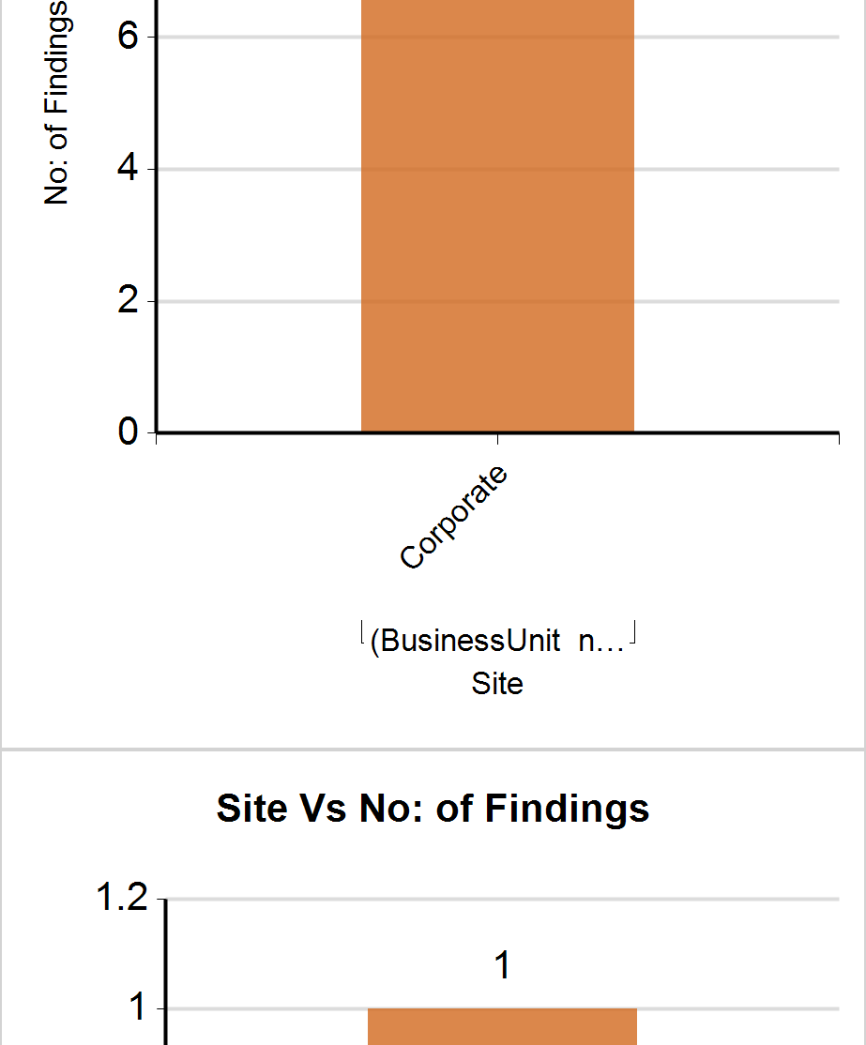
Consolidated Findings Report
Click here to view findings report
ETL Job Last Executed On (Date & Time) :
27 Apr 2021 12:55:29 PM
Category :
Auto Components
Classification :
Automobiles & Component

Slide 20
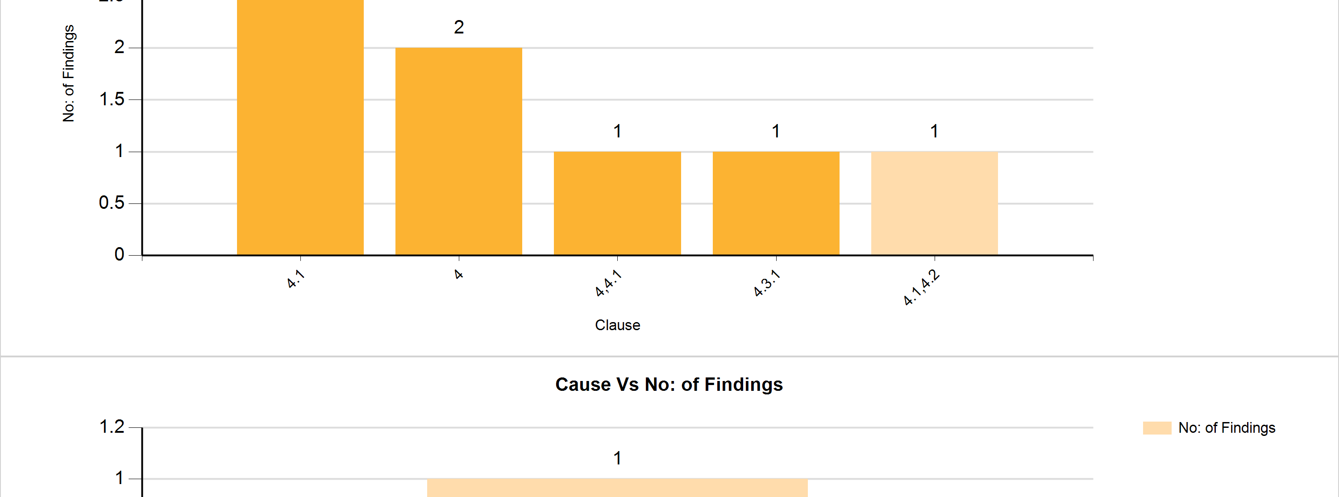
Consolidated Findings Report
Click here to view findings report
ETL Job Last Executed On (Date & Time) :
27 Apr 2021 12:55:29 PM
Category :
Auto Components
Classification :
Automobiles & Component

Slide 21
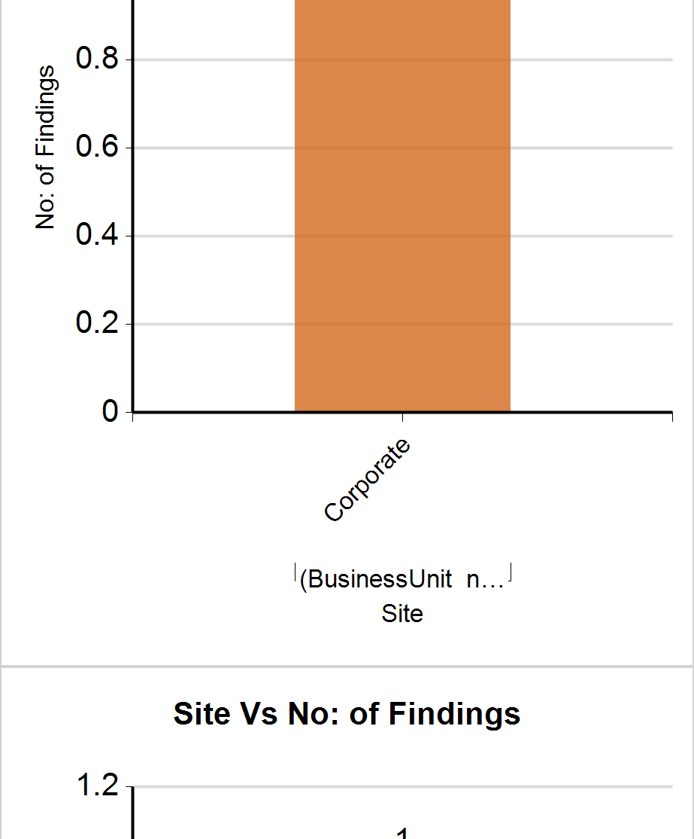
Consolidated Findings Report
Click here to view findings report
ETL Job Last Executed On (Date & Time) :
27 Apr 2021 12:55:29 PM
Category :
Auto Components
Classification :
Automobiles & Component

Slide 22
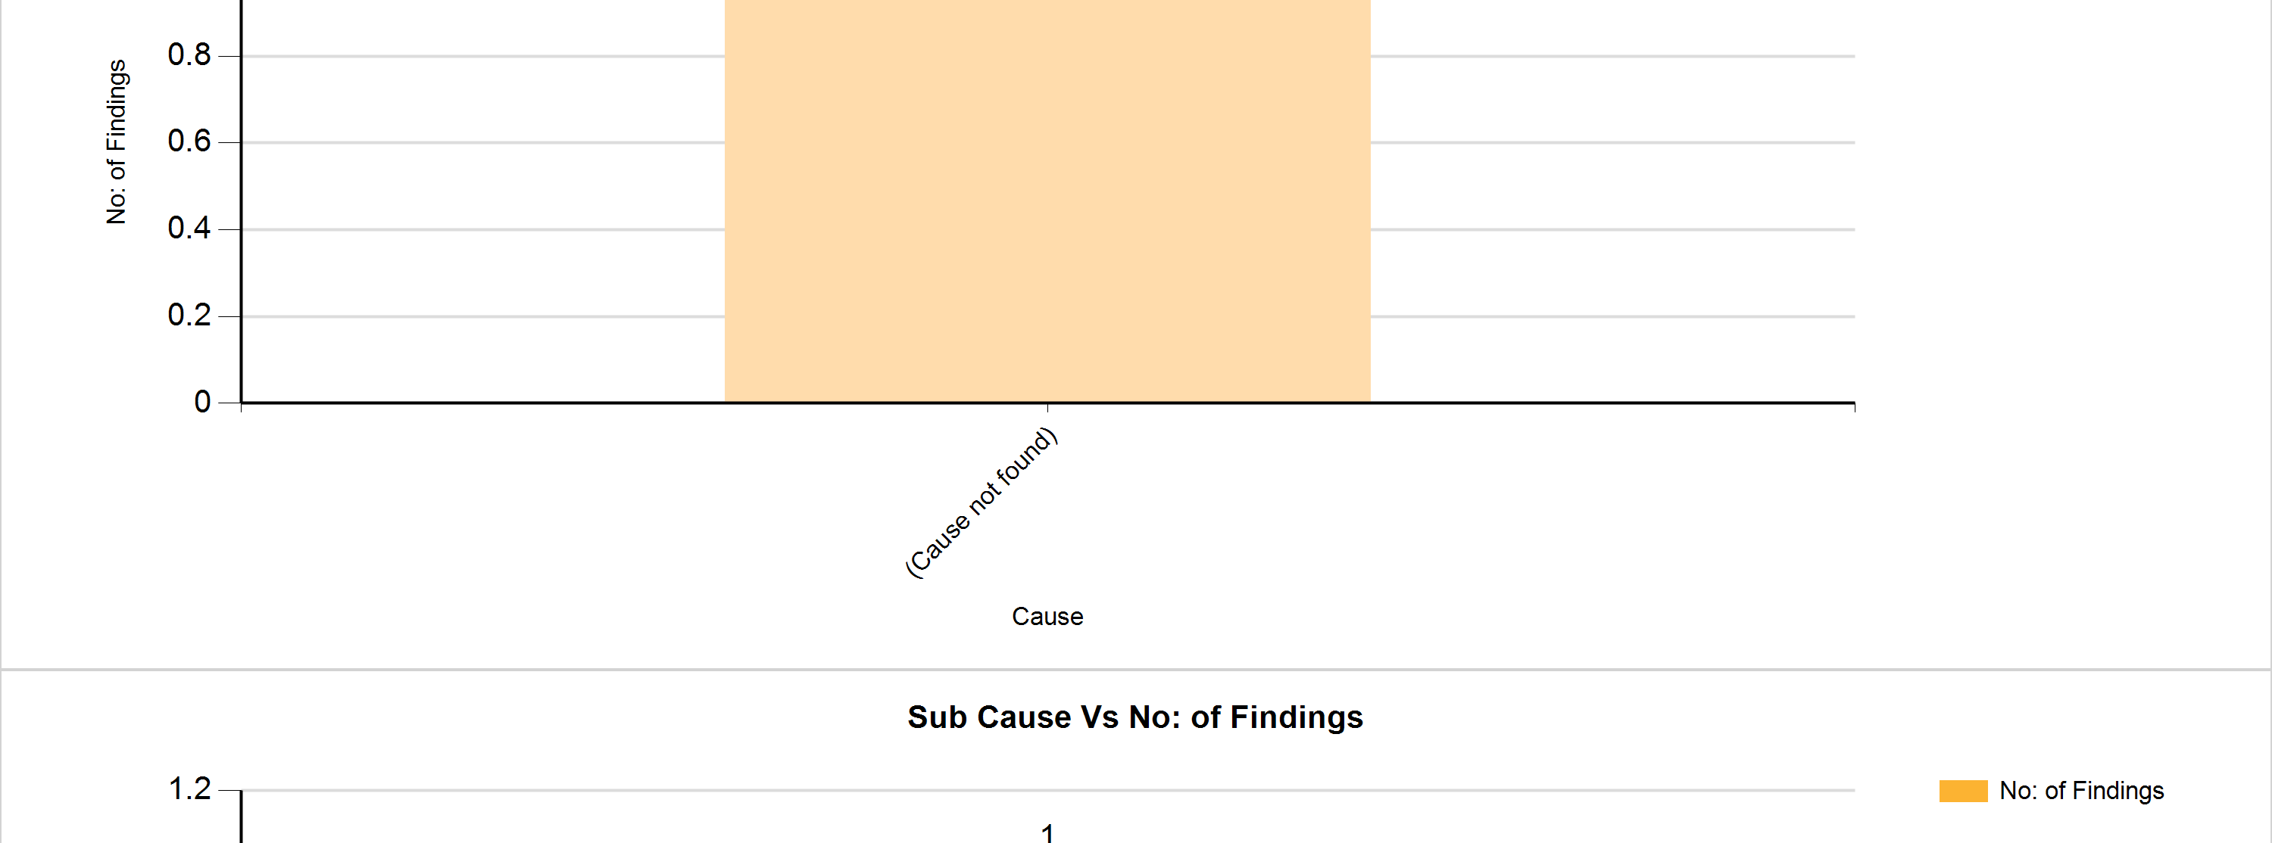
Consolidated Findings Report
Click here to view findings report
ETL Job Last Executed On (Date & Time) :
27 Apr 2021 12:55:29 PM
Category :
Auto Components
Classification :
Automobiles & Component

Slide 23
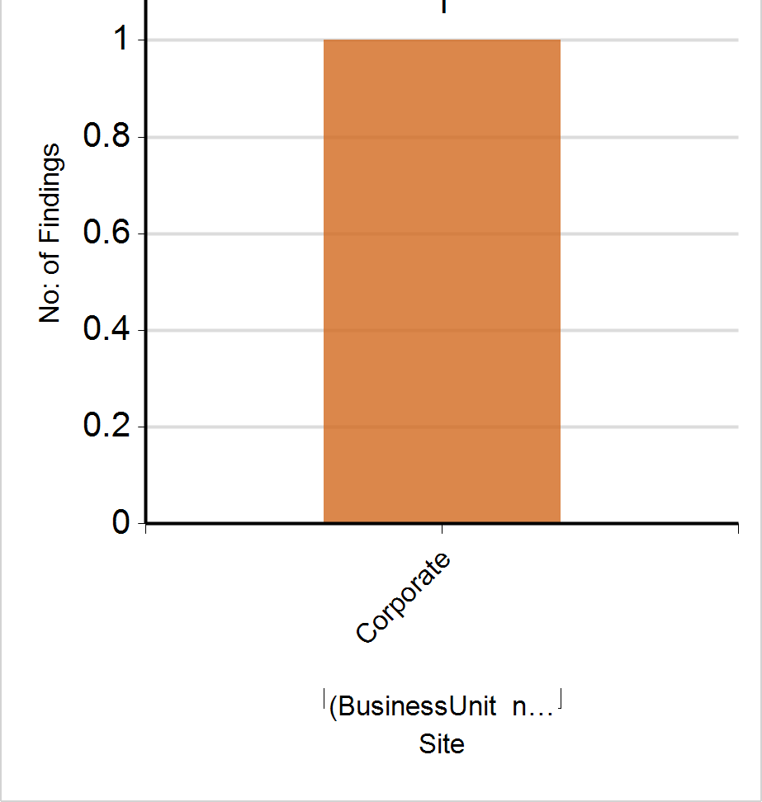
Consolidated Findings Report
Click here to view findings report
ETL Job Last Executed On (Date & Time) :
27 Apr 2021 12:55:29 PM
Category :
Auto Components
Classification :
Automobiles & Component

Slide 24
Consolidated Findings Report
Click here to view findings report
ETL Job Last Executed On (Date & Time) :
27 Apr 2021 12:55:29 PM
Category :
Auto Components
Classification :
Automobiles & Component

Slide 25
Consolidated Findings Report
Click here to view findings report
ETL Job Last Executed On (Date & Time) :
27 Apr 2021 12:55:29 PM
Category :
Auto Components
Classification :
Automobiles & Component

Slide 26
Consolidated Findings Report
Click here to view findings report
ETL Job Last Executed On (Date & Time) :
27 Apr 2021 12:55:29 PM
Category :
Auto Components
Classification :
Automobiles & Component

