Slide 1
ITAR features in EwQIMS

Slide 2
Suite
The application validates whether users created are US citizens and also there will be an option to attach the proof. (This is not applicable when the user comes from LDAP)
If the citizenship of user is changed manually, a log is maintained with the audit trail details.
AquaPro
There will be an option to categorize production items as ITAR or not.
The ITAR compliant Production Item can be created only by ITAR compliant users.
The process and design documents of ITAR compliant Production Item will not be visible to any users other than US citizens.
When a Production Item is ITAR compliant, the application validates one level above and below, so that the information of any ITAR Production Item available in that hierarchy is not accessible to any non ITAR user. This applied only when BOM is attached to production items.
The documents of an ITAR compliant Production Item when published will be an ITAR compliant document in Docpro and also accessible only to ITAR compliant users.
DocPro
When a document is uploaded to Docpro by an ITAR compliant user, an option is provided to denote whether the document is ITAR compliant or not.
ITAR compliant documents are not displayed to non ITAR users

Slide 3
AuditPro
The Application validates whether Audit Program, Audit Type and Audit Forms are ITAR Compliant. If the Audit Program is ITAR compliant, system will list ITAR users as MR Approver, Primary and Secondary Auditee contact person and Qualified Auditors.
Application validates whether Audit Schedule is ITAR compliant, based on that system will list Audit Program and Audit Type for scheduling the Audit.
The Application validate whether Audit Program and Audit Type is ITAR compliant. If it is ITAR compliant, system will list ITAR users as Auditee contact person, Lead Auditors and Auditors while scheduling Audits
LPA
The Application validate whether Equipment, Checklist and Layer are ITAR Compliant. Only ITAR team or Users will be assigned as Auditors for ITAR Layer.
While scheduling LPA Audit, based on the Layer selection, ITAR Equipments will be listed for scheduling Audit. System will assign ITAR users as Auditors.
Reports
All reports will show up ITAR related data only to ITAR users.

Slide 4
SUITE

Slide 5
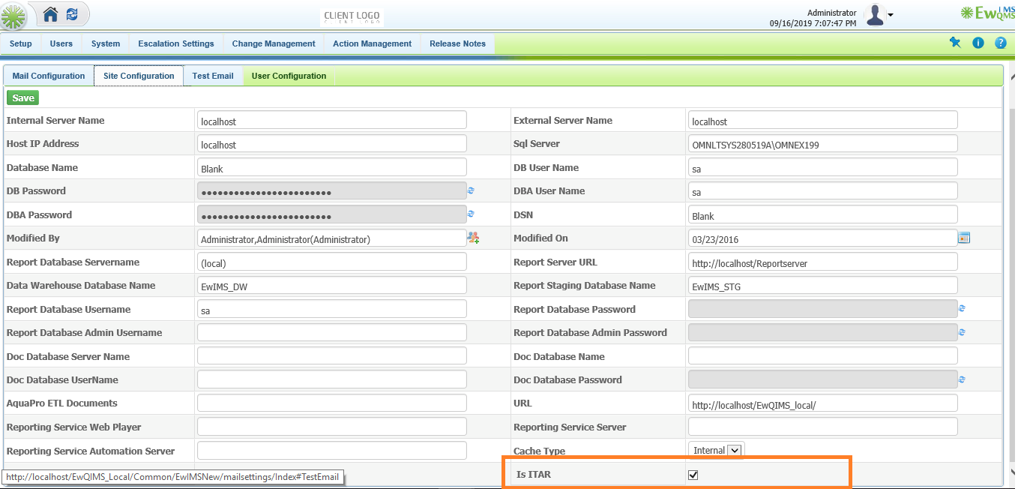
Configuration Settings
A business rule is provided to enable ITAR compliant for the Site

Slide 6
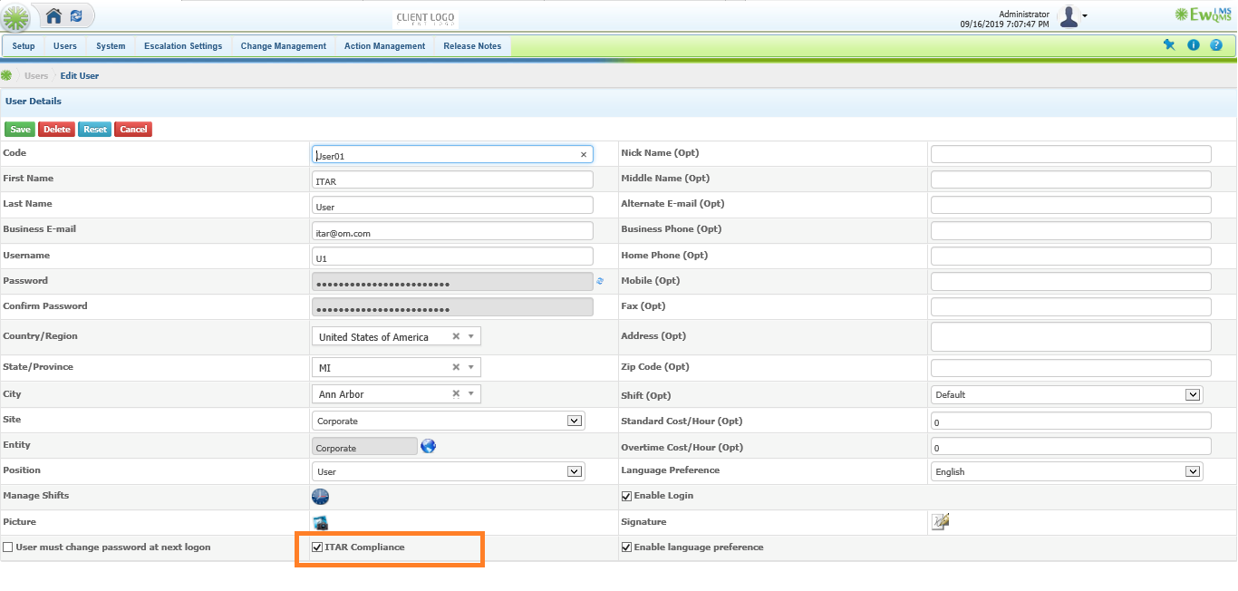
User Creation
The application validates whether users created are ITAR Compliant. Only Administrator has the rights to create Users and assign whether they are ITAR compliant or not

Slide 7
AQUAPRO

Slide 8
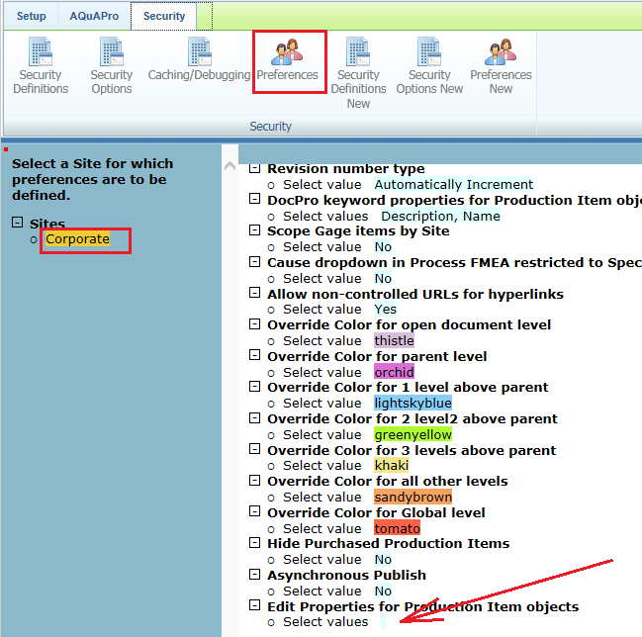
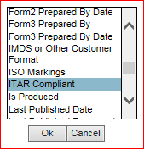
Preferences
Click on Preference and click on a Site to pop up the Preference screen
A popup to select multiple PI properties displayed. The ITAR Compliant property will not show up unless the website implements ITAR and the current user is an ITAR user.

Slide 9
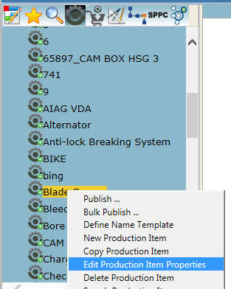
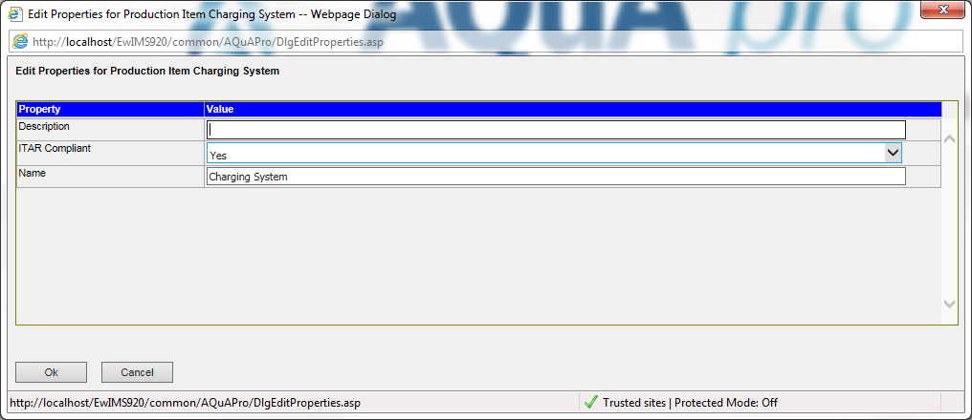
Production Item Properties
Right click on a PI in the top left pane, to see Edit Production Item Properties
On clicking the menu will display the dialog box with the properties selected in Preferences that the user can edit
Note: If a user is not an ITAR user, they still see the ITAR Compliant property and if they change the value and save it, an alert is prompted that they don’t have access

Slide 10
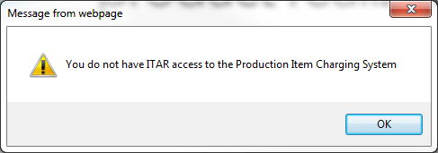
The ITAR documents are visible only to US citizens
If a Non ITAR user tries to open an ITAR document, an alert is prompted as shown below

Slide 11
DOCPRO

Slide 12
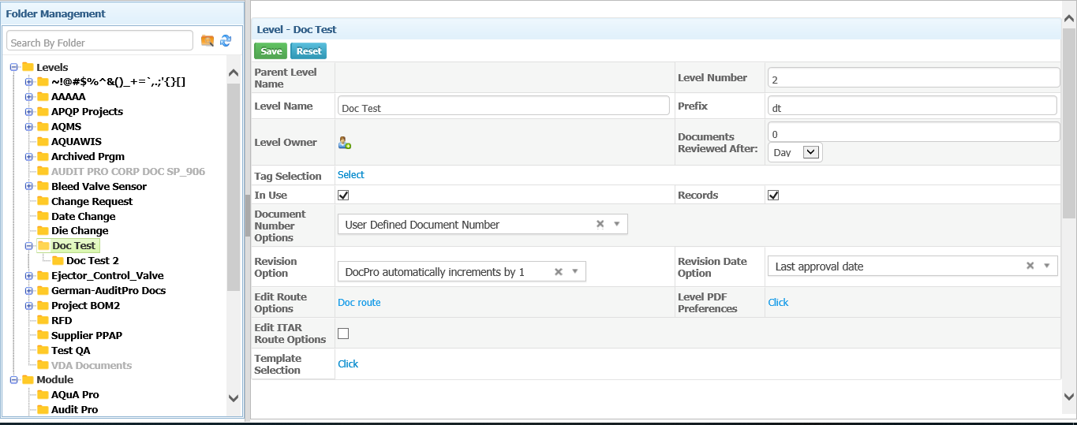
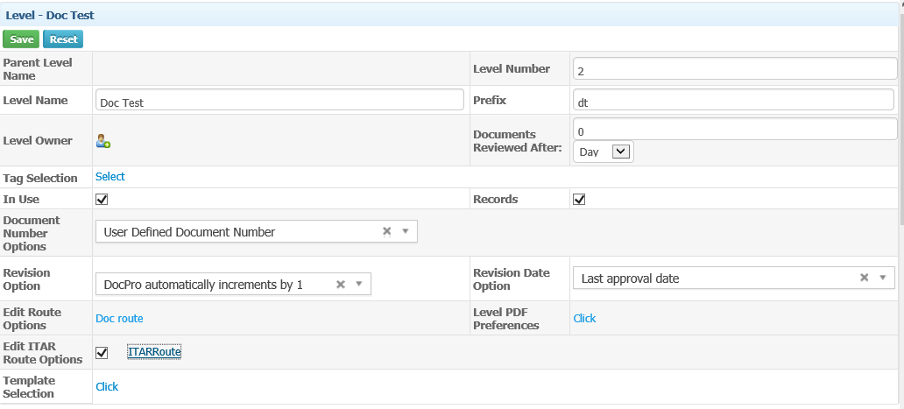
Folder Management
An option to select ITAR route is provided in Folder Management
Select the ITAR Route

Slide 13
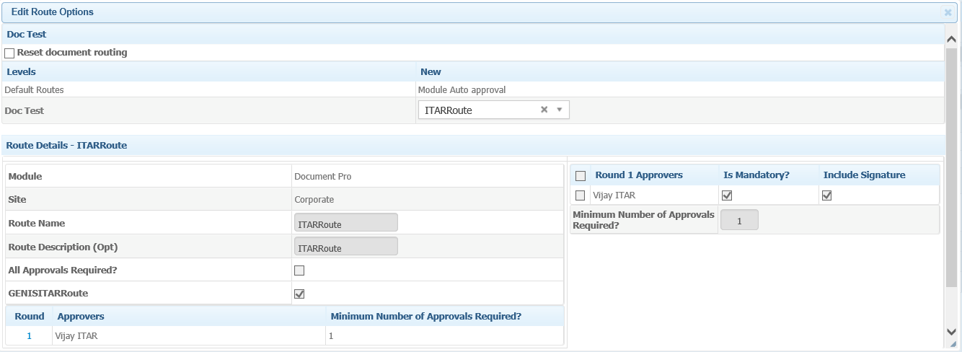
Route Creation
An option to select whether a Route is ITAR or Not in Route creation screen

Slide 14
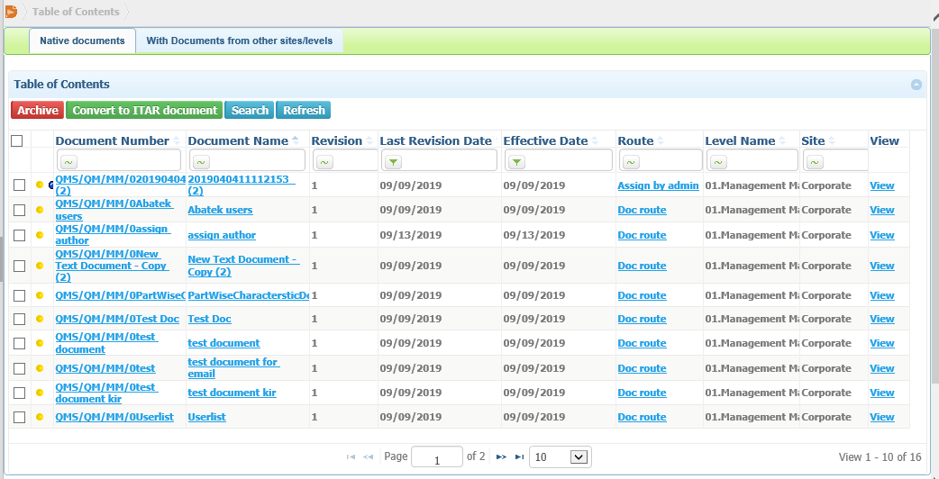
Document Management
A button provided to convert a Non ITAR document to an ITAR document in Document Management.
An yellow icon provided to denote ITAR documents

Slide 15
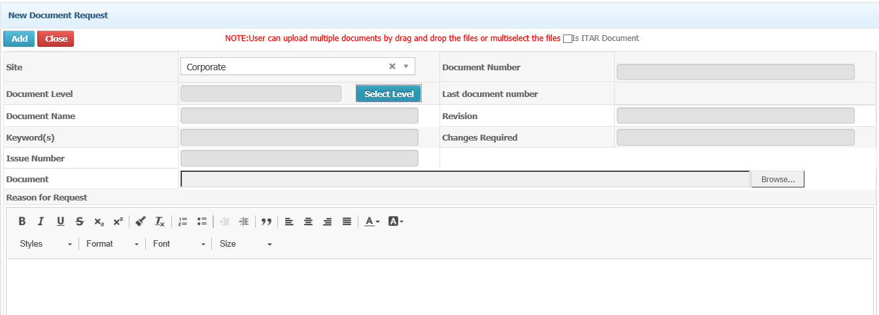
New Document Request
An option provided to denote the document uploaded as ITAR

Slide 16
AUDITPRO

Slide 17
Audit type : ITAR user can define Audit type as ITAR/Non ITAR such that the ITAR Audit Type will not be listed to Non ITAR user.
Based on the selection of dropdown, the Audit Type can be set as ITAR /Non ITAR

Slide 18
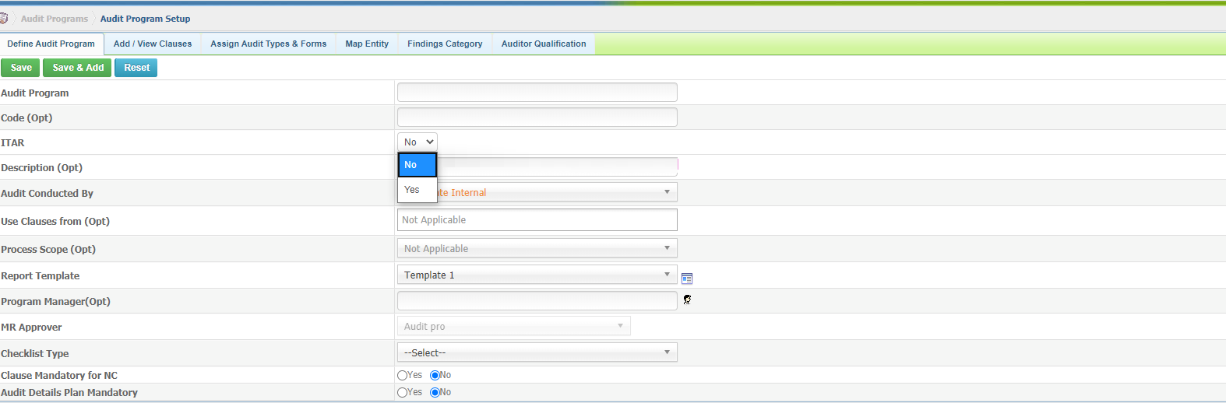
Audit Program: ITAR user can define Audit Program as ITAR/Non ITAR such that the ITAR Audit Program will not be listed to Non ITAR user
Default selection is No. Based on the selection audit program will be ITAR/Non ITAR

Slide 19
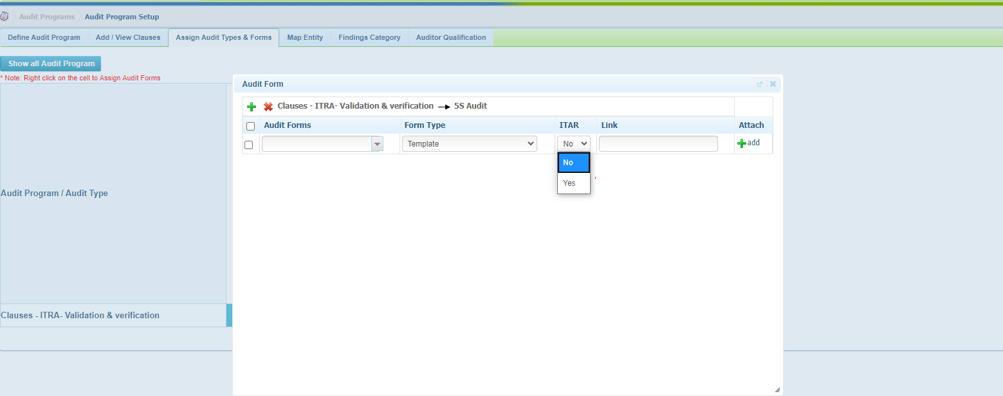
Audit Form: Template/Reference ->ITAR user can define Audit form as ITAR or Non ITAR.
Based on the Audit Type dropdown will be enabled

Slide 20
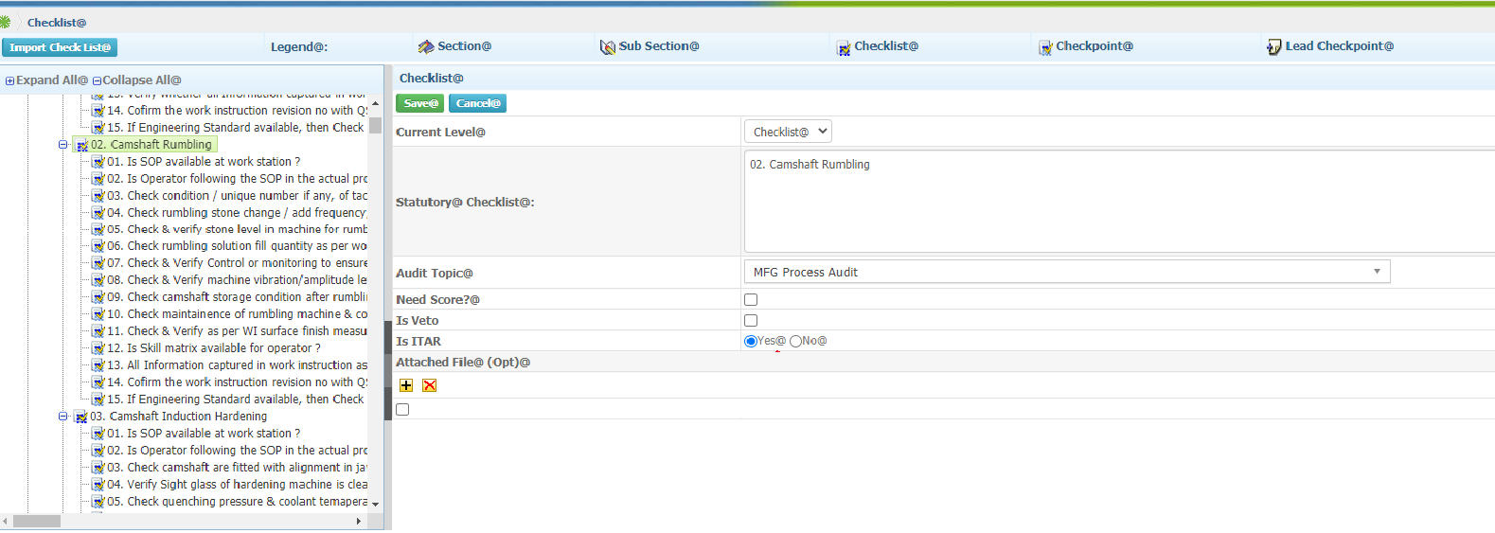
Checklist : ITAR user can define Checklist as ITAR/Non ITAR such that the ITAR checklist will not be listed to Non ITAR user.
Once ITAR checklist is used in schedule, Admin cannot change the checklist as Non ITAR

Slide 21
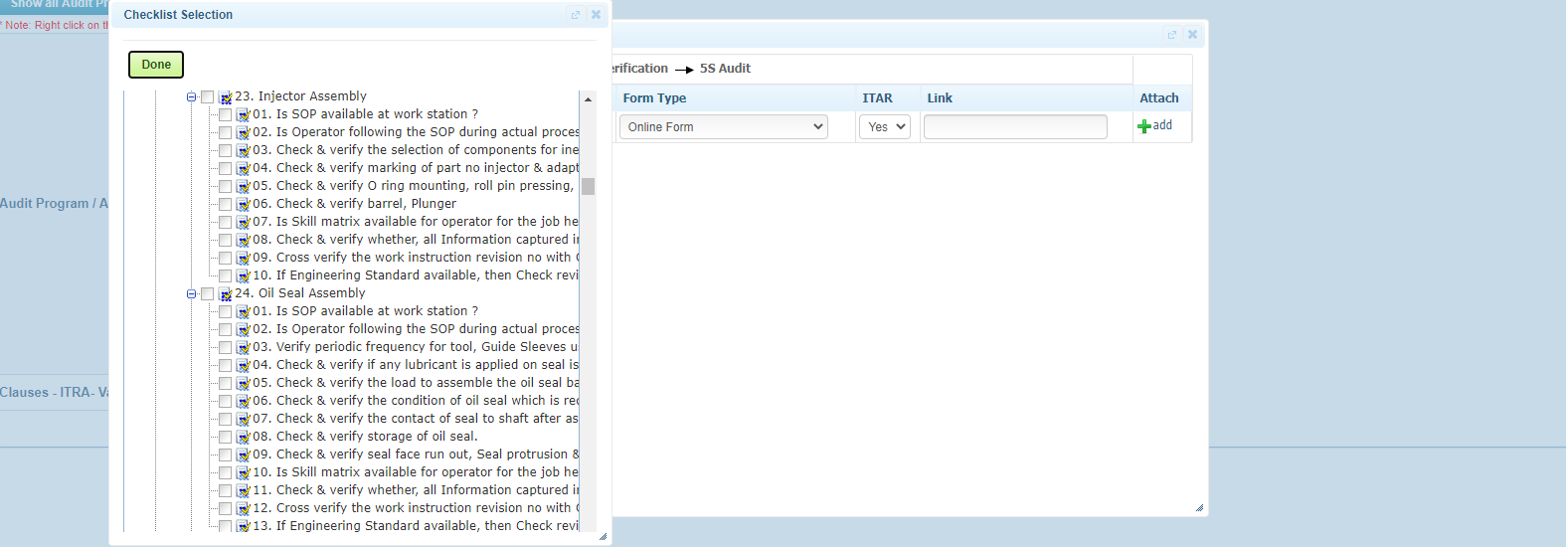
Audit Form: Online form ->Checklist will be displayed based on dropdown “Yes/ No”. If it is “Yes” only ITAR checklist will be displayed and for “No” Non ITAR Checklist will be displayed.
Based on selection, Checklist will be displayed as ITAR/Non ITAR

Slide 22
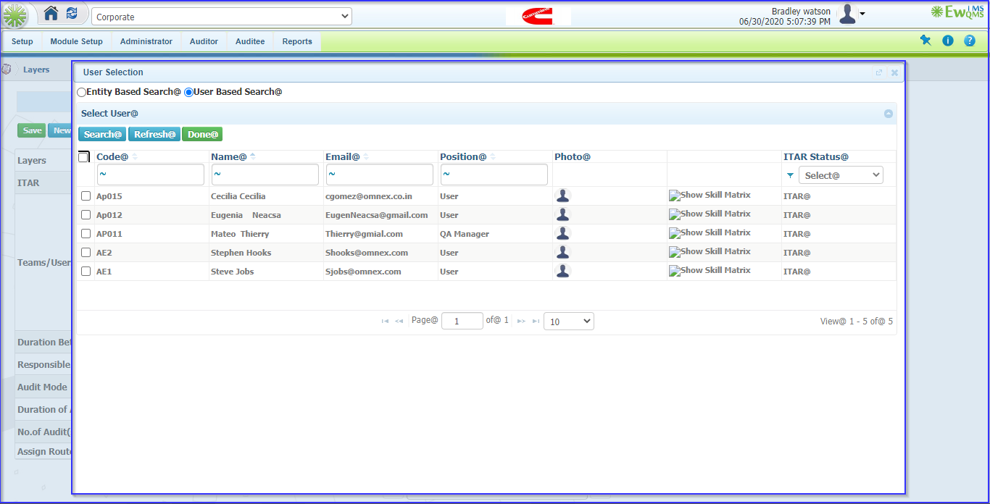
User selections : User selection will list only ITAR users in fields Auditor, Responsible person and teams as well if the Audit Program is ITAR.
If audit Program is ITAR it will displays the ITAR users.

Slide 23
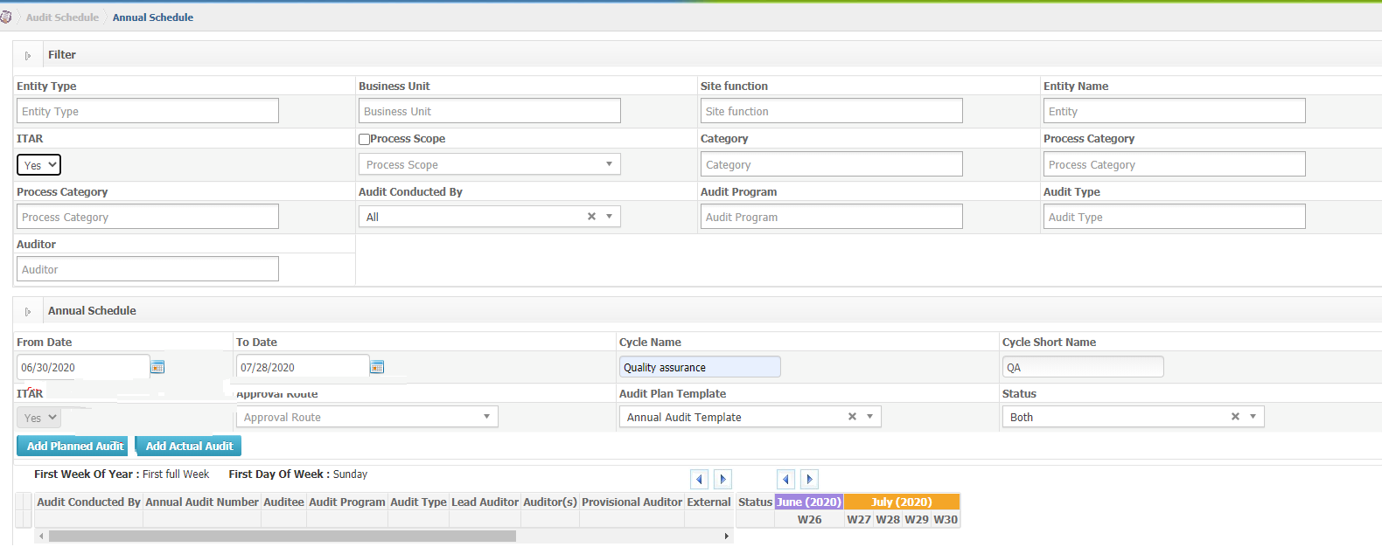
Audit Schedule: We can schedule audit as ITAR/Non ITAR. Audit program and Audit type will be displayed based on the specification.
Filter are dependent
Using the dropdown, we can schedule audit as ITAR/Non ITAR

Slide 24
LPA

Slide 25
Equipments : ITAR User can specify whether the equipment is ITAR or Non-ITAR by checking the Box IS ITAR as Yes

Slide 26
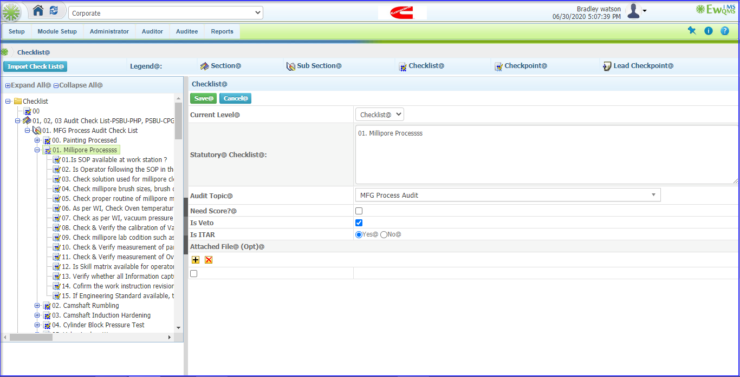
Checklist : ITAR user can define Checklist as ITAR/Non such that the ITAR Checklist will not be listed to Non ITAR user and cannot be used by non ITAR admin

Slide 27
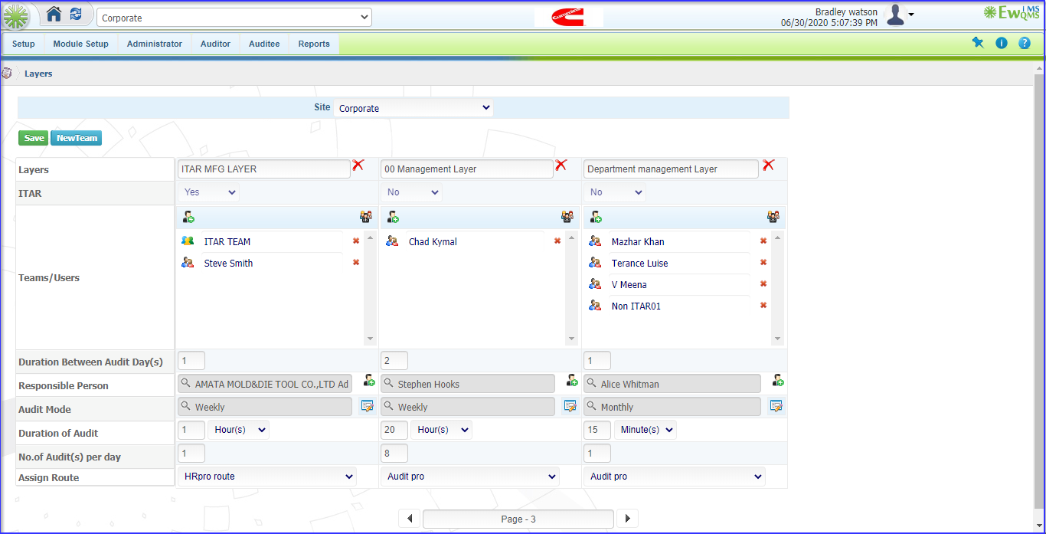
Layers : ITAR admin can specify whether the Layer is ITAR or Non ITAR. If it’s ITAR, it will not be listed to non ITAR admin in layers. If ITAR user creates a Non ITAR layer, it will be listed to non ITAR admin as well.

Slide 28
User selections : User selection lists ITAR users in fields Auditor, Responsible person and teams as well if the Layer is ITAR

Slide 29
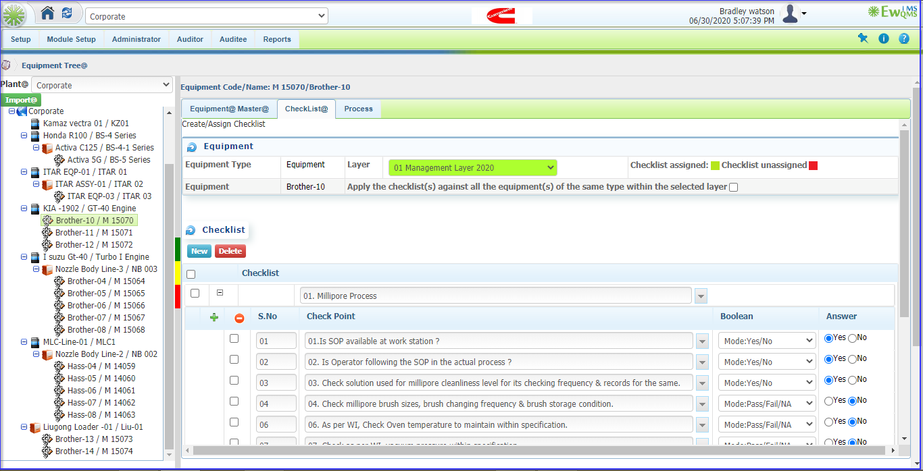
ITAR Checklist Assign to Equipment : System allows Only ITAR Checklist to assigned to ITAR equipment

Slide 30
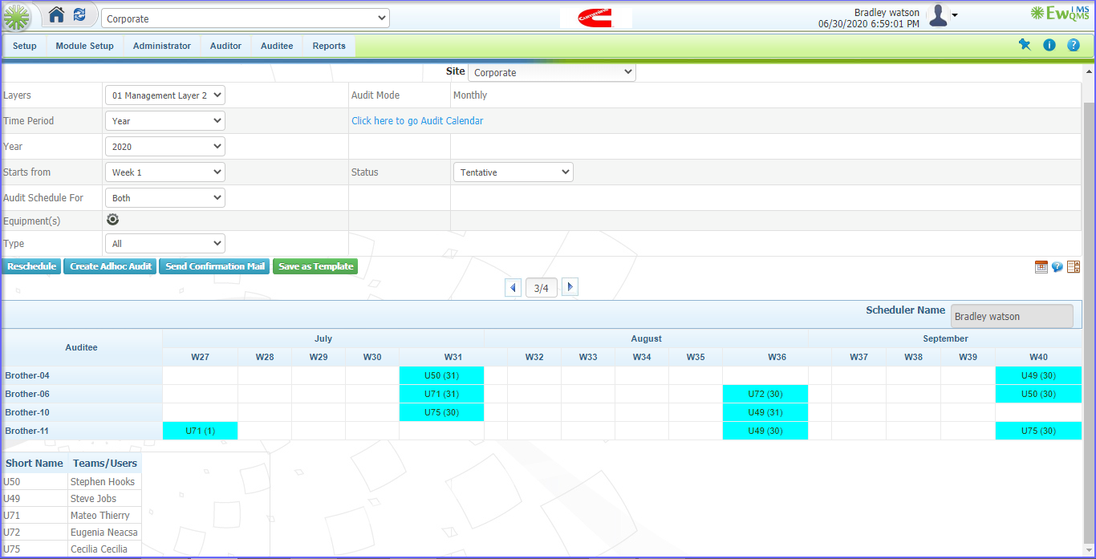
LPA Scheduling : LPA Schedule will be the combination of ITAR Checklist, ITAR Equipment , ITAR Layer ,ITAR auditor and ITAR responsible persons…etc…!

Slide 31
PROBLEM SOLVER

Slide 32
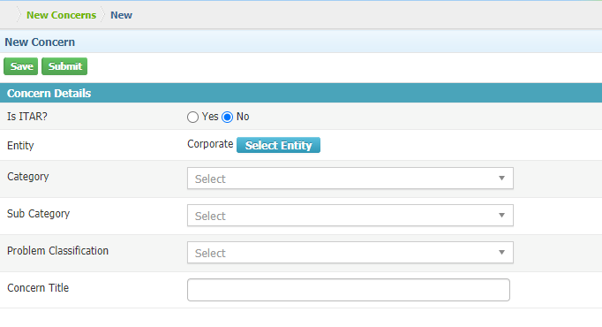
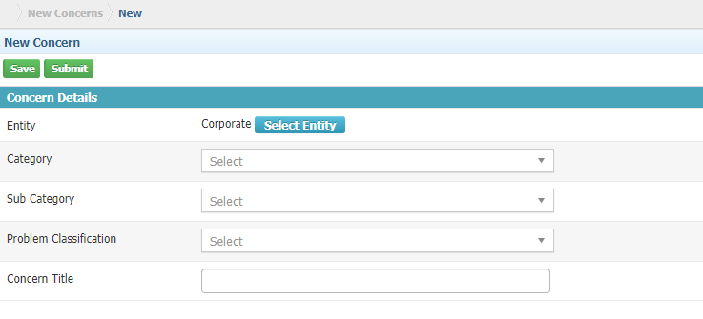
ITAR user can only see this option

Slide 33
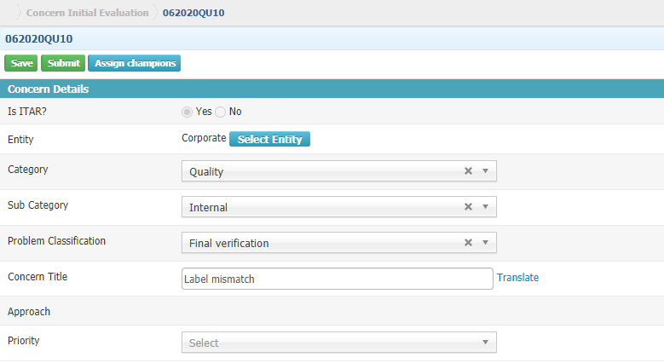

Slide 34
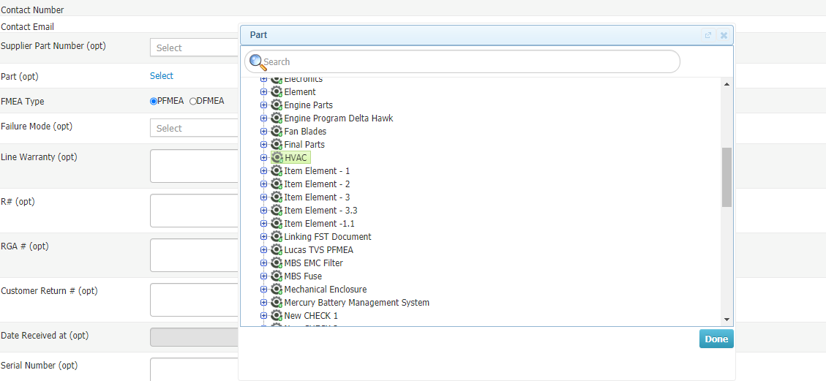
ITAR parts will be listed only for ITAR concerns

Slide 35
ITAR concerns will not be listed for Non-ITAR users
ITAR
Non-ITAR

Slide 36
THANK YOU

